Slide 1


FINANCIAL RISK MANAGEMENT AND ENGINEERING
Session 2: Market Risk Basics: Returns, Volatility & Correlation
Notes:
Session 2 opens the quantitative core of the course. By 13:00 students will have computed annualised volatility, beta to their bloc index, a rolling correlation matrix, an EWMA series, and a fitted GARCH(1,1) - all on their own stocks. These numbers feed directly into Assignment 1.

Slide 2
Learning Objectives
By the end of this session, you will be able to:
1. Compute simple and log returns and explain why logs are preferred (time-additivity, stationarity)
2. Describe the stylised facts of returns: fat tails, volatility clustering, near-zero autocorrelation
3. Implement EWMA volatility (Hull Ch.8) and interpret the RiskMetrics decay factor lambda
4. Fit and interpret a GARCH(1,1) model: persistence, long-run variance, half-life
5. Estimate beta with the market model and split risk into systematic vs idiosyncratic (Jorion Ch.5)
6. Build a rolling correlation matrix and explain why correlations rise in crises (Longin & Solnik 2001)
Notes:
Seven objectives map onto the four blocks and the lab. Objective 5 (beta / market model) is new this revision and ties to the dashboard; objective 7 makes the exam linkage explicit.

Slide 3
The Distribution Toolkit
Four modelling jobs
Returns and P&L - how big is a typical move and how fat are the tails: Normal, Student-t, Lognormal, Generalized Pareto
Counts of events - how many defaults, losses or jumps: Bernoulli/Binomial, Poisson
Times between events - how long until the next default or loss: Exponential
Rates and proportions on [0,1] - recovery, probability of default: Beta
Inference and testing
Chi-square and F underpin variance estimation, goodness-of-fit, and model-comparison tests
Notes:
Overview: every risk number is a quantile or moment of some distribution. Group them by the modelling job - returns/P&L, event counts, waiting times, bounded rates - plus the inference distributions.

Slide 4
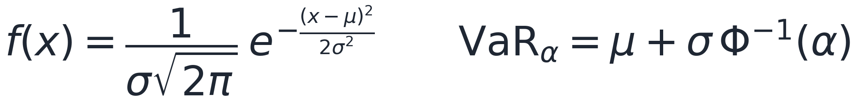
Normal (Gaussian) Distribution
Main feature
Symmetric bell curve fully described by its mean mu and variance sigma^2
Thin tails (kurtosis = 3); a sum of independent normals is again normal
Justified by the Central Limit Theorem for sums of many small shocks
Benefits
Analytically tractable - closed-form VaR = mu + sigma x z_alpha and simple portfolio aggregation
Only two parameters to estimate; the backbone of the variance-covariance method
Uses in risk management
Parametric (delta-normal) VaR and RiskMetrics; portfolio return modelling
Normal log-returns underlie Black-Scholes; the null hypothesis in normality tests
Caveat: underestimates extreme losses - real returns are fat-tailed
Notes:
The workhorse and the benchmark. Two parameters, closed-form VaR, aggregates cleanly - but thin tails make it understate extreme losses, which motivates the t and EVT.

Slide 5
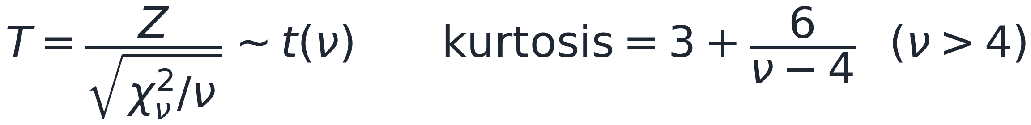
Student-t Distribution
Main feature
Symmetric like the normal but with heavier tails; the degrees of freedom nu control tail thickness
Excess kurtosis when nu > 4; as nu grows it converges to the normal
Benefits
Captures fat tails and extreme moves the normal misses, with just one extra parameter
Standardised t is a drop-in innovation for GARCH-t volatility models
Uses in risk management
Fat-tailed VaR and Expected Shortfall; GARCH(1,1)-t daily return models
The t-copula for joint tail dependence (joint crashes across assets)
Small-sample inference and regression t-statistics (e.g. testing whether a beta is significant)
Notes:
Same symmetric shape as the normal but heavier tails controlled by nu. The default fat-tailed choice for daily returns, GARCH innovations, and the t-copula.

Slide 6
Lognormal Distribution
Main feature
A variable whose logarithm is normal; strictly positive and right-skewed
Arises from multiplicative (compounding) growth rather than additive shocks
Benefits
Never goes negative - the natural model for prices, values and loss sizes
Consistent with geometric Brownian motion and normal log-returns
Uses in risk management
Asset and stock PRICE modelling (the Black-Scholes underlying)
Loss SEVERITY in operational-risk loss-distribution models; positive quantities such as rates
Notes:
If the log is normal, the level is lognormal - positive and right-skewed. The natural model for prices (GBM) and for loss severities.

Slide 7
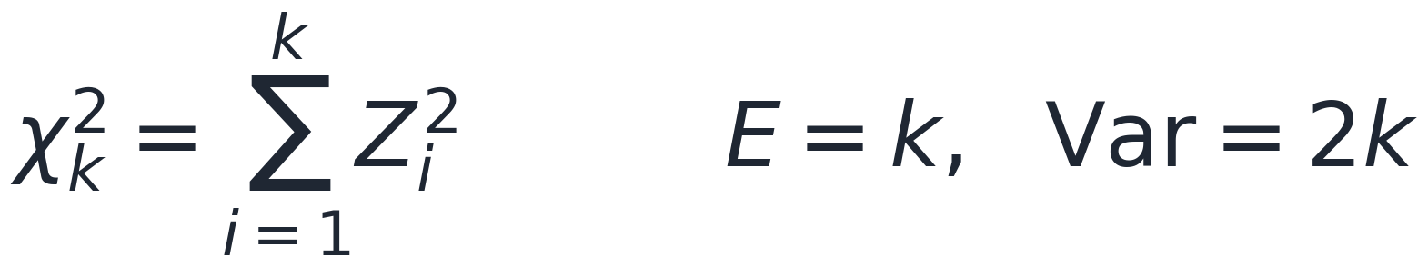
Chi-Square Distribution
Main feature
The distribution of a sum of k squared standard normals; positive and right-skewed
Mean = k and variance = 2k; approaches the normal as the degrees of freedom k grow
Benefits
Links naturally to variances (sums of squares) and to likelihood-based tests
Uses in risk management
Variance and covariance inference; goodness-of-fit and normality tests (Jarque-Bera is chi-square with 2 df)
Likelihood-ratio tests for nested models (e.g. ARCH vs GARCH)
VaR backtesting: the Kupiec POF and Christoffersen independence tests are chi-square
Notes:
The distribution of sums of squared normals - so it governs variances and most goodness-of-fit and likelihood-ratio tests, including several VaR backtests.

Slide 8
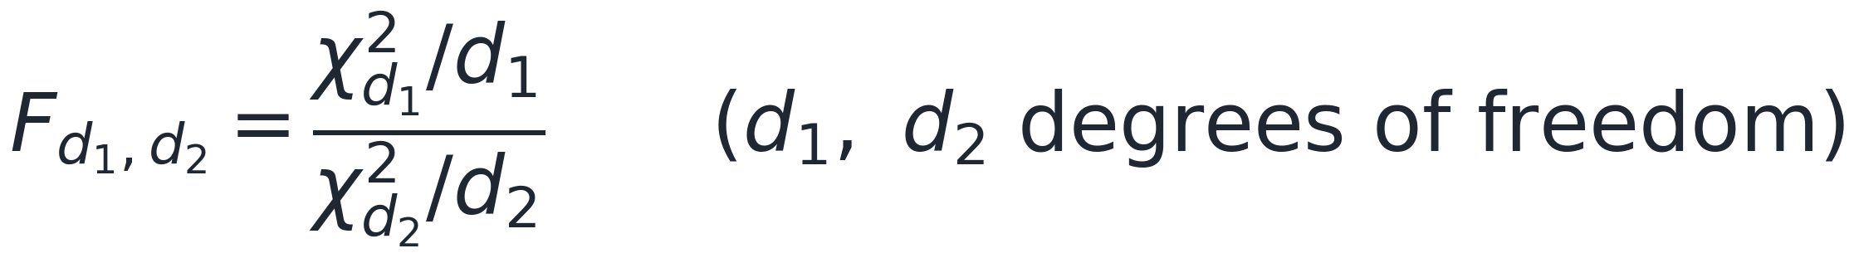
F-Distribution
Main feature
The ratio of two independent scaled chi-square variables; positive and right-skewed
Two degrees-of-freedom parameters (numerator and denominator)
Benefits
Purpose-built to compare two variances or the fit of two nested models
Uses in risk management
Joint significance tests in factor models and regressions (an F-test on several betas at once)
Comparing volatility between two periods or assets (variance-ratio tests); ANOVA in factor analysis
Notes:
A ratio of two scaled chi-squares - purpose-built to compare two variances or the fit of two models. Shows up in factor-model F-tests and variance-ratio comparisons.

Slide 9
Generalized Pareto Distribution (EVT)
Main feature
Models only the TAIL - the distribution of exceedances over a high threshold (peaks-over-threshold)
The shape parameter xi sets tail heaviness; xi > 0 gives a heavy (power-law) tail
Benefits
Concentrates the data on the extremes and is theoretically justified for tails (Pickands-Balkema-de Haan)
Extrapolates beyond the largest observed loss - essential for rare events
Uses in risk management
Extreme VaR and Expected Shortfall at very high confidence (99.9%); operational-risk capital
Tail-index estimation and tail stress testing (Extreme Value Theory)
Notes:
The tail specialist. Extreme Value Theory says exceedances over a high threshold follow a GPD, so it is the tool for very-high-confidence VaR/ES and operational-risk capital.

Slide 10
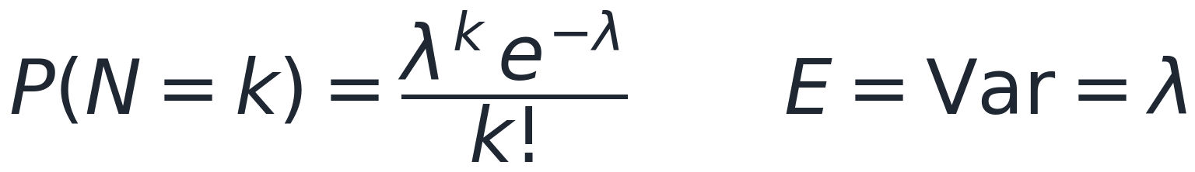
Poisson Distribution
Main feature
Counts of rare, independent events in a fixed interval, governed by a single rate lambda
Mean = variance = lambda; sums of independent Poissons are again Poisson
Benefits
The simplest event-count model and the building block of compound loss models
Uses in risk management
Operational-loss FREQUENCY in the compound-Poisson loss-distribution approach (frequency x severity)
Number of defaults in a pool; jump counts in jump-diffusion; arrival of claims or trades
Notes:
The event-count model. Combined with a lognormal severity it gives the compound-Poisson loss model at the heart of operational-risk LDA.

Slide 11
Bernoulli and Binomial Distributions
Main feature
Bernoulli: a single yes/no outcome (default or no default) with probability p
Binomial: the number of defaults among n independent obligors, each with probability p
Benefits
The natural, interpretable model for default events and probabilities of default (PD)
Uses in risk management
Credit default modelling and PD; binomial trees for option pricing
Counting VaR exceptions in backtesting (the basis of the Kupiec test)
Caveat: real defaults are correlated - independence understates portfolio tail risk
Notes:
The default-event model. Bernoulli is one obligor; Binomial counts defaults across n independent obligors and underlies the Kupiec exception count. Real defaults are correlated - a key caveat.

Slide 12
Exponential Distribution
Main feature
The time until the first event (or between events); a constant hazard rate lambda
Memoryless: elapsed time does not change the remaining waiting time
Benefits
A simple survival/hazard model; the interarrival time of a Poisson process
Uses in risk management
Reduced-form (intensity) credit models: time-to-default with hazard lambda
Interarrival times of losses and jumps; survival and waiting-time analysis
Notes:
The waiting-time model and the interarrival time of a Poisson process. Its constant hazard makes it the baseline for reduced-form (intensity) credit models.

Slide 13
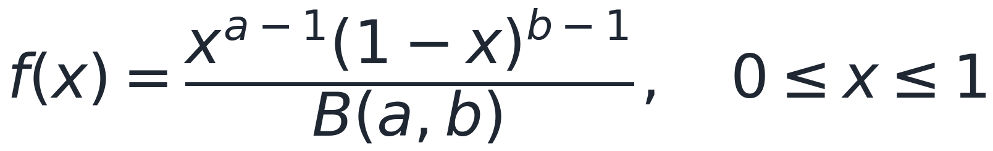
Beta Distribution
Main feature
Bounded on [0,1] with two shape parameters a and b; can be U-shaped, bell-shaped or skewed
Benefits
The flexible default choice for proportions, rates and probabilities; conjugate prior for Bernoulli
Uses in risk management
Recovery rates and loss-given-default (LGD) modelling
Bayesian estimation of default probabilities; any quantity constrained to [0,1]
Notes:
Bounded on [0,1] and very flexible - the go-to for proportions and rates such as recovery/LGD, and the conjugate prior for Bayesian PD estimation.

Slide 14
Choosing the Right Distribution
Market risk
Normal for quick parametric VaR; Student-t and Generalized Pareto when tails are fat; Lognormal for prices and severities
Credit risk
Bernoulli/Binomial for defaults; Exponential for time-to-default; Beta for recovery / loss-given-default
Operational risk
Compound Poisson x Lognormal for frequency x severity; Generalized Pareto for the extreme tail
Inference and testing
Chi-square for variance and goodness-of-fit; F for comparing variances and joint significance
Notes:
Wrap-up map. Match support and tail behaviour to the phenomenon, then validate with Q-Q plots and goodness-of-fit before trusting a risk number.

Slide 15
Block 1: Stylised Facts of Financial Returns
The empirical regularities every risk model must capture
Before modelling volatility, we look at what real daily return data actually looks like.
Three stylized facts:
  fat tails
  volatility clustering
  near-zero autocorrelation in levels
Notes:
Block 1: before we model, we must understand what real return data looks like. The three stylised facts motivate every model in Blocks 2 and 3.

Slide 16
Exchange Rates Changes: Normally Distributed
 | Real World (%) | Normal Model (%)
>1 SD | 23.32 | 31.73
>2SD | 4.67 | 4.55
>3SD | 1.30 | 0.27
>4SD | 0.49 | 0.01
>5SD | 0.24 | 0.00
>6SD | 0.13 | 0.00
Notes:
Block 1: before we model, we must understand what real return data looks like.

Slide 17
Heavy Tails
Daily exchange rate changes are not normally distributed
  The distribution has heavier tails than the normal distribution
  It is more peaked than the normal distribution
This means that small changes and large changes are more likely than the normal distribution would suggest
Many market variables have this property, known as excess kurtosis

Slide 18
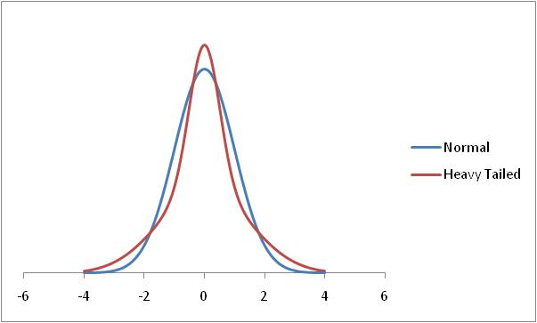
Normal and Heavy-Tailed Distribution

Slide 19
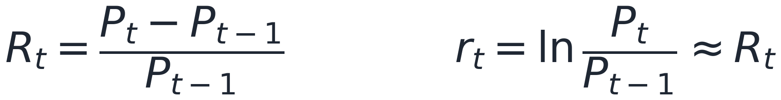
Simple vs Log Returns
Two definitions
Simple return R(t) is the price-relative change; log return r(t) = ln[P(t) / P(t-1)] is approximately R(t) for small moves
Log returns are time-additive: the multi-day log return is the sum of the daily log returns
Simple returns are portfolio-additive: R(p) is the weighted sum of the constituent simple returns
Why risk management uses log returns
Additivity, symmetry and approximate stationarity make modelling tractable
Annualize: st.dev (annual) = st.dev (daily) x sqrt(252) and av.return(annual) = av.return(daily) x 252
Data: yfinance adjusted Close (splits and dividends), daily frequency
Notes:
Stress time-additivity: if daily log returns are i.i.d. N(mu, sigma^2) then the T-day return is N(T mu, T sigma^2), giving the root-T scaling rule that underpins VaR scaling in Session 3.

Slide 20
The Lognormal Model and Square-Root-of-Time
The lognormal price model (Jorion Ch.5)
Prices follow geometric Brownian motion, so log returns are normal and prices are lognormal (never negative)
The drift scales with time t; the standard deviation scales with sqrt(t) - the square-root-of-time rule
Why it matters for risk
Motivates log returns and the sqrt(252) annualisation used throughout EWMA and GARCH
Underpins sqrt(T) VaR scaling in Session 3: a 10-day VaR = 1-day VaR x sqrt(10) IF returns are i.i.d. with constant vol
The rule breaks under volatility clustering - the GARCH term structure (later this session) is the correction
Notes:
The lognormal price model formalises log returns and the root-t scaling of volatility, which underpins both the sqrt(252) annualisation and sqrt(T) VaR scaling in Session 3. Emphasise the caveat: root-T breaks when volatility is time-varying - exactly what the GARCH term structure fixes.

Slide 21
Empirical Properties of Financial Returns
1) Fat tails (leptokurtosis)
Excess kurtosis > 0 for most assets; S&P 500 daily kurtosis is roughly 10 to 20
The normal underestimates extreme events by an order of magnitude - VaR and ES need fat-tailed distributions
2) Volatility clustering
Large moves follow large moves; calm follows calm (Mandelbrot 1963)
Returns r(t) show near-zero autocorrelation, but squared returns r²(t) are strongly autocorrelated
3)Asymmetry (leverage effect)
Negative returns raise future volatility more than positive returns (Black 1976); return/vol-change correlation approx -0.7 for the S&P 500
Captured by GJR-GARCH and EGARCH
4) Near-zero autocorrelation of returns
Daily returns are largely unpredictable, consistent with weak-form efficiency
But r(t) and r²(t) are strongly autocorrelated - volatility is predictable even when direction is not (Jorion Ch.5)
Notes:
Cont (2001) is the classic survey - the supplementary reading. Walk through the ACF plot from the lab: returns show no autocorrelation, squared returns show strong autocorrelation. This motivates GARCH.

Slide 22
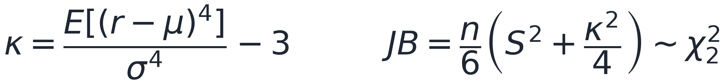
Fat Tails: Normal vs Student-t
The problem with the normal
Under the normal a 99% VaR sits at 2.33 sigma, and a 3-sigma day has probability 0.13%
The normal predicts a 3-sigma S&P 500 day about once per 741 years; historically, it is roughly once per 2 to 3 years
Jarque-Bera rejects normality for virtually every daily return series
The fix: Student-t and EVT
The t(nu) distribution has heavier tails; typical nu approx 4 to 8; as nu grows it approaches the normal
GARCH(1,1) with t errors (arch library) captures fat tails inside a time-series model
Extreme Value Theory (Peaks-Over-Threshold with the GPD) models the tail directly
Historical simulation captures fat tails with no distributional assumption
Notes:
Show the Q-Q plot from the lab: points above the line at both extremes - the tell-tale sign of fat tails. A t with nu approx 6 fits far better. This matters for VaR (Session 3) and ES (Session 4).

Slide 23
Volatility Clustering
The statistical signature
Periods of high volatility cluster together in time
Returns r(t): autocorrelation approx 0 at all lags (random-walk-like)
Squared returns r²(t): strong positive autocorrelation out to 100+ lags
Why it matters
Rolling 21-day vol swings widely: GFC 2008 (approx 80% annualised), COVID 2020 (approx 90%)
VIX (implied vol) correlates approx 0.85 with EWMA realised vol
A static historical sigma is a poor risk measure - we need adaptive models (EWMA, GARCH)
Notes:
Reference the lab, top panel: SPY daily returns clearly cluster. Then EWMA tracks the clusters while a 21-day rolling window lags behind. This motivates all of Block 2.

Slide 24
Block 2: Volatility Models
Historical - EWMA - GARCH(1,1) - from Hull Ch.8
Historical rolling volatility is the simple baseline
EWMA weights recent data more heavily with a single decay factor
GARCH(1,1) adds a long-run level and mean reversion
Notes:
Block 2: the three volatility estimators the course uses. Historical is the baseline; EWMA adds recency weighting; GARCH(1,1) adds mean reversion. All three are implemented in the lab.

Slide 25
Standard Approach to Estimating Volatility
Define σ_{n} as the volatility per day between day n−1 and day n, as estimated at end of day n−1
Define S_{i} as the value of market variable at end of day i
Define u_{i}= ln(S_{i}/S_{i-1})
Notes:
Block 2: the three volatility estimators the course uses. Historical is the baseline; EWMA adds recency weighting; GARCH(1,1) adds mean reversion. All three are implemented in the lab.

Slide 26
Simplifications Usually Made in
Risk Management
Define u_{i} as (S_{i}−S_{i−1})/S_{i−1}
Assume that the mean value of u_{i} is zero
Replace m−1 by m
This gives

Slide 27
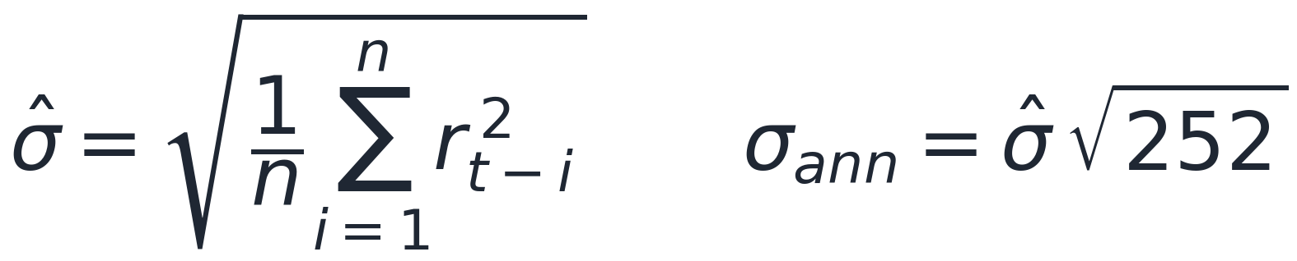
Historical (Rolling) Volatility
The simplest estimator
Sample standard deviation of log returns over a trailing window of n days (zero-mean simplification)
RiskMetrics default n = 25; Basel internal-models minimum n = 250 trading days; annualise by sqrt(252)
Strengths and weaknesses
Pro: simple, no parametric assumption, automatically captures fat tails
Con: equal-weights every observation - a big event stays in the estimate until it falls off the window
Ghost effect: vol drops sharply exactly n days after a shock even if markets stayed calm
Python: rets.rolling(window).std() * np.sqrt(252)
Notes:
Demonstrate the ghost effect: if 15 Oct had a 5% drop, rolling vol stays elevated for exactly n days then drops on 15 Nov even if nothing happened. This is why EWMA is preferred for risk systems.

Slide 28
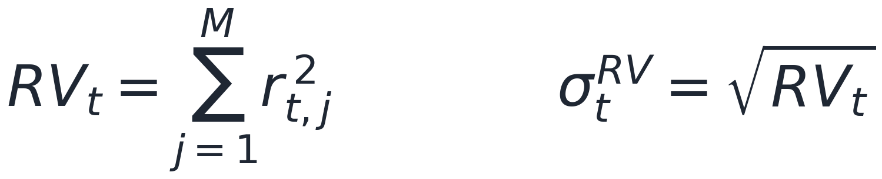
Realized Volatility
Measuring volatility from high-frequency data
Realized variance sums squared intraday returns over the day; realized vol is its square root
As sampling frequency rises, RV converges to the true (integrated) variance - a nearly model-free measure
Far more accurate than a single daily squared return as a volatility proxy
Why it matters (Andersen, Bollerslev, Diebold & Labys 2003)
Turns latent volatility into something we can observe and forecast directly
Serves as the realised benchmark when scoring EWMA and GARCH forecasts (the QLIKE loss)
Practical caveat: microstructure noise and non-trading hours require careful sampling (e.g. 5-minute returns)
Notes:
(Andersen, Bollerslev, Diebold & Labys 2003 - supplementary reading). Realized variance sums squared intraday returns and converges to the integrated variance as sampling frequency rises. It is the realised benchmark used to score EWMA/GARCH forecasts (the QLIKE comparison).

Slide 29
Weighting Scheme
Instead of assigning equal weights to the observations we can set

Slide 30
ARCH(m) Model
In an ARCH(m) model we also assign some weight to the long-run variance rate, V_{L}:

Slide 31
Exponentially Weighted Moving Average (EWMA)
Interpretation
In an exponentially weighted moving average model, the weights assigned to the u² decline exponentially as we move back through time
No window length n - EWMA uses all past data with exponentially declining weights lambda^{i-1}
No ghost effect: old shocks fade smoothly
RiskMetrics (J.P. Morgan, 1994) popularised lambda = 0.94 (daily) and 0.97 (monthly)
We need only remember the current estimate of the variance rate and the most recent observation on the market variable
Notes:
Work through the recursion numerically: if sigma^2_{t-1}=0.01 and r_{t-1}=-0.03 then sigma^2_t = 0.94x0.01 + 0.06x0.0009 = 0.009454. The lab implements this loop step by step; the same recursion gives covariances.

Slide 32
GARCH(1,1)
The three terms
ω = γV_{L} sets the long-run (unconditional) variance
Alpha weights last period's squared return (the ARCH term - reaction to news)
Beta weights last period's variance (the GARCH term - persistence)
Typical S&P 500: alpha approx 0.15, beta approx 0.84, alpha+beta approx 0.99
Key quantities
Persistence alpha+beta must be < 1 for stationarity; near 1 means shocks decay slowly
Long-run variance V(L) = omega/(1 - alpha - beta); long-run vol = sqrt(252) V(L)
Estimated by maximum likelihood (arch library); EWMA is the special case omega = 0
Notes:
SPY GARCH(1,1) from the lab: omega=0.024, alpha=0.155, beta=0.834, persistence=0.989, long-run annualised vol approx 16%, half-life approx 63 days. Contrast EWMA: no mean reversion (persistence = 1 by construction).

Slide 33
GARCH(1,1) Example
Suppose
The long-run variance rate is 0.0002 so that the long-run volatility (st.dev) per day is 1.4%
Suppose that the current estimate of the volatility is 1.6% per day and the most recent percentage change in the market variable is 1%.
The new variance rate is
The new volatility (st.dev) is 1.53% per day

Slide 34
GARCH(1,1) - Properties and Intuition
Mean reversion and persistence
When 𝛔2(t) exceeds V(L) the model forecasts a decline back toward V(L)
Persistence alpha+beta controls how slowly variance mean-reverts; S&P 500 half-life approx 60 to 70 days
Student-t errors (GARCH-t) improve the tail fit; typical nu approx 5 to 8
Diagnostics and extensions
Standardised residuals z(t) = r(t) / 𝛔 (t) should be approximately i.i.d.
Model checks: Ljung-Box on z²(t); AIC and BIC; QLIKE loss
Extensions: GJR-GARCH and EGARCH capture the leverage effect
Implementation: arch_model(ret, vol='Garch', p=1, q=1, dist='t')
Notes:
Walk through the lab: fit, summary table, conditional volatility series, standardised residuals. The res.conditional_volatility array is the key output feeding parametric VaR and ES in Sessions 3 to 4.

Slide 35
Volatility Model Comparison
1) Historical rolling
Window n (default 21); equal weights; no parameters to estimate
Ghost effect and abrupt level shifts; good for regulatory disclosure (Basel n = 250)
2) EWMA (RiskMetrics)
One fixed parameter lambda (0.94 / 0.97); exponential decay, no ghost effect
No mean reversion (persistence = 1 by construction); good for short-horizon VaR and correlation
3) GARCH(1,1)
Three parameters omega, alpha, beta; mean-reverts to the long-run variance V_L
Best multi-day forecast accuracy; captures clustering + mean reversion; good for multi-day VaR and stress testing
How to choose
QLIKE loss (Patton 2011); Mincer-Zarnowitz R²; LR test for nested models; AIC/BIC otherwise
GARCH usually wins on accuracy, EWMA on speed and simplicity; the lab does the formal comparison
Notes:
For Assignment 1, students report ALL THREE estimates for their portfolio, then discuss which they prefer for VaR (Session 3) and why. The QLIKE comparison in the lab gives them a formal score.

Slide 36
Forecasting Volatility - the GARCH Term Structure
Reading the forecast
GARCH forecasts mean-revert to V(L) at rate (alpha+beta) per day
Today's shock lifts the whole forward vol curve; high persistence means a slow decay
When 𝛔²(t) > V(L) the term structure slopes down; when below, it slopes up
Why it matters
EWMA cannot forecast forward (flat curve, persistence = 1)
Explains why the naive sqrt(T) VaR rule fails when volatility is non-constant
Feeds 10-day VaR scaling in Session 3 and Assignment 1 (Hull Ch.8)
Notes:
The forward-looking payoff of GARCH over EWMA. When sigma^2_t is above V_L the curve slopes down; below, it slopes up. This is what justifies scaling a 1-day vol to a multi-day horizon under time-varying vol.

Slide 37
Implied Volatility and the VIX
Backward- vs forward-looking
Historical, EWMA and GARCH vols are estimated from past returns (backward-looking)
Implied volatility is backed out of option prices via Black-Scholes (forward-looking)
VIX = 30-day implied vol of S&P 500 options (CBOE), annualised - the 'fear gauge'
Using it
Crisis spikes approx 80% (GFC 2008) and approx 82% (COVID 2020) vs approx 12 to 20% in calm markets
Implied usually exceeds realised vol - the variance risk premium
VIX correlates approx 0.85 with EWMA realised vol - a real-time cross-check
Implied vol varies by strike - the volatility smile/skew, revisited in Session 8
Notes:
Backward- vs forward-looking is the key contrast. Overlay the VIX (^VIX) on EWMA realised vol in the lab - they track closely but VIX leads at turning points. The persistent gap (implied > realised) is the variance risk premium.

Slide 38
Block 3: Correlation, Covariance and Beta
The glue between assets - Hull Ch.9 and Jorion Ch.5
Covariance and correlation summarise co-movement; beta measures sensitivity to the market
Correlations are dynamic and rise in crises; copulas capture the dependence that correlation misses
Notes:
Block 3: from individual volatilities to the covariance matrix, beta, and the dependence structure. This is where market risk becomes portfolio risk. Correlations are stable in calm markets and break in crises (Longin & Solnik 2001).

Slide 39
Covariance and Correlation
Definitions
Correlation ⍴ lies in [-1, +1]: +1 perfect co-movement, 0 no linear relation, -1 perfect opposite
The EWMA recursion extends to covariances, giving a time-varying correlation matrix
Portfolio variance is w-transpose Sigma w - the fundamental object in portfolio risk
Properties
The covariance matrix Sigma must be positive semi-definite
Hull Ch.9 builds the EWMA correlation matrix; Jorion Ch.5 uses risk-factor covariances in VaR
Correlation is not causation and captures only LINEAR dependence - nonlinear/tail dependence needs copulas
Notes:
The covariance matrix is the fundamental object in all portfolio risk. The lab builds a rolling 63-day correlation matrix for SPY, AAPL, GS; students replicate this with their own three stocks in Assignment 1.

Slide 40
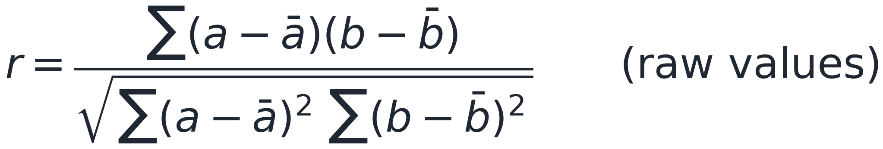
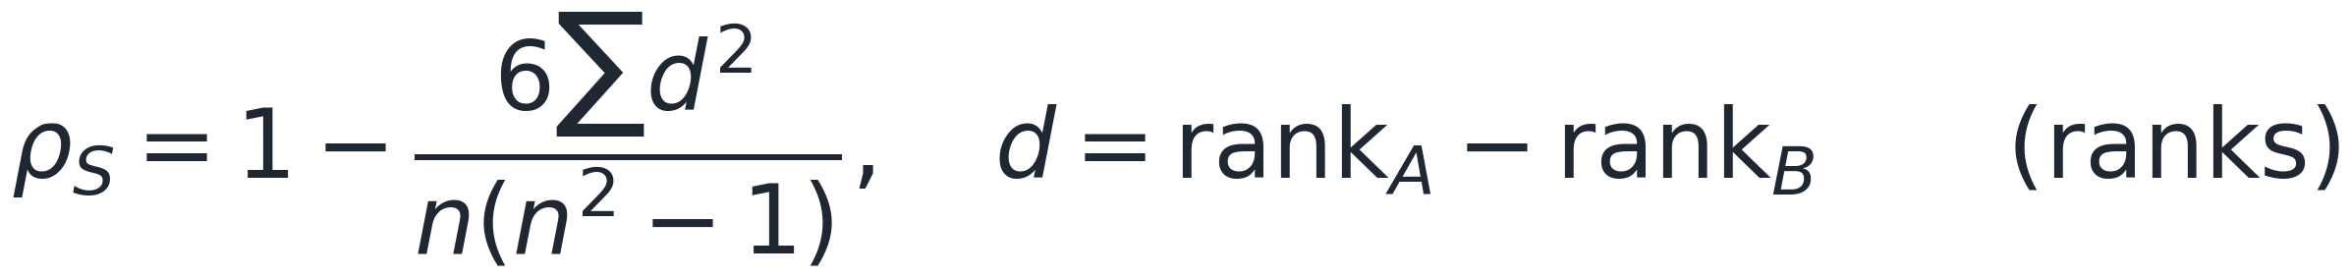
Pearson vs Spearman Correlation
Pearson - linear association on the raw values
Uses the actual sizes of the deviations from the mean; equals +/-1 only for a straight-line relationship
Sensitive to outliers and marginal scale; feeds covariance and portfolio VaR (w-transpose Sigma w)
Spearman - monotonic association on the ranks
Pearson applied to the ranks; equals +/-1 for ANY increasing relationship, even a curved one
Robust to outliers (a rank shifts by at most 1) and works on ordinal data too
The decisive difference
Replace a variable by any increasing function (log, cube): Spearman is unchanged, Pearson changes
That scale-free, marginal-free property is why Spearman is the natural measure for a copula
When to use each
Use Pearson for linear, well-behaved data that feeds variance and VaR formulas. Use Spearman or Kendall for monotonic, fat-tailed, ordinal, or copula work. When in doubt, compute both and read the gap between them.
Notes:
Contrast slide. Pearson measures linear co-movement of the raw values; Spearman is the same formula on the ranks, so it measures monotonic co-movement and is scale-free and outlier-robust. The invariance point is the punchline: any increasing transform of a variable leaves Spearman unchanged but moves Pearson, which is why copulas (dependence with marginals removed) are described with rank measures. Anchor it with the worked example: 0.94 vs 0.88, the gap driven by the two big joint days.

Slide 41
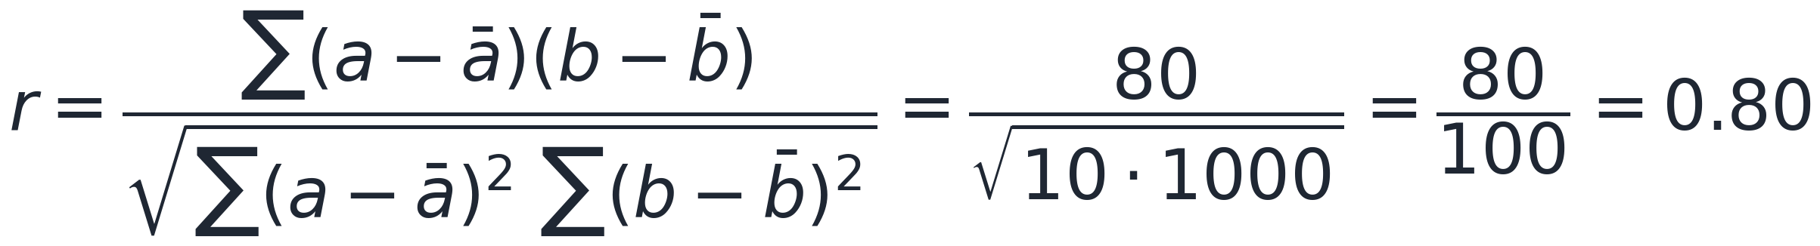
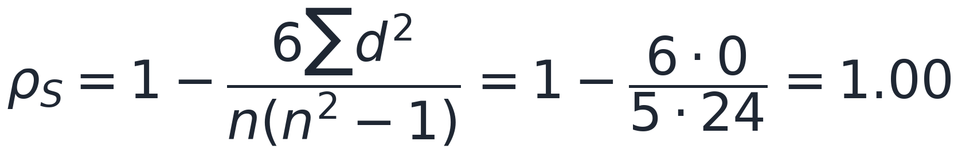
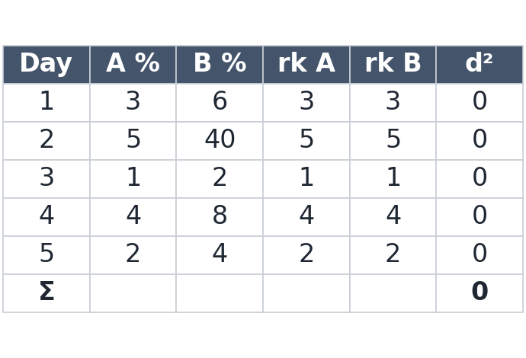
Computing Both Correlations: Example
Pearson - on the raw values
Means A-bar = 3, B-bar = 12; the deviation products sum to 80; the squared-deviation sums are 10 and 1000
r = 80 / sqrt(10 x 1000) = 80 / 100 = 0.80
Spearman - on the ranks
Rank each stock 1 to 5; the ranks match exactly, so every d = rank A - rank B is 0 and sum d^2 = 0
rho_S = 1 - 6(0)/(5 x 24) = 1.00
Read it
Perfectly ordered together (Spearman = 1.00) but not a straight line, because of the day-2 jump (Pearson = 0.80)
Notes:
The worked example. Pearson uses the actual sizes: sum of deviation products 80 over sqrt(10 x 1000) = 0.80. Spearman uses only ranks: they agree perfectly, so sum d^2 = 0 and rho = 1.00. The gap is the nonlinearity: the day-2 jump to 40 keeps the order intact (Spearman sees perfection) but bends the line (Pearson drops). The next slide shows this as a picture.

Slide 42
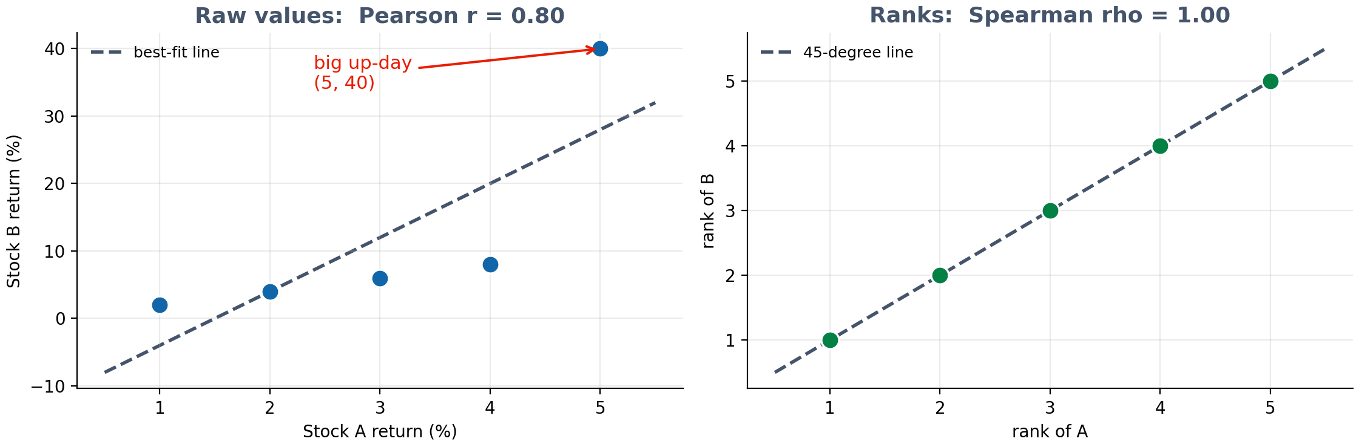
Seeing the Difference: Raw Values vs Ranks
Left (raw returns): four points line up, but the big up-day (5, 40) pulls the best-fit line off them, so Pearson = 0.80
Right (ranks): every point sits exactly on the 45-degree line, so Spearman = 1.00 - perfect order
Same data, two answers: Pearson penalises the nonlinearity and the outlier; Spearman sees only the ordering
Notes:
The visual punchline. On the left the raw points would be collinear except the day-2 up-day at (5,40), which levers the fitted line away from the other four points - that imperfection is why Pearson is 0.80. On the right, ranks put all five points exactly on the diagonal, so Spearman is 1.00. Use this to cement: Pearson measures straight-line fit, Spearman measures order.

Slide 43
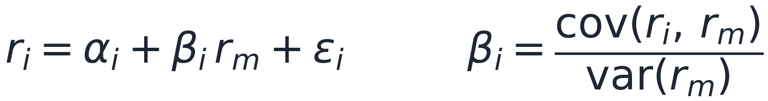
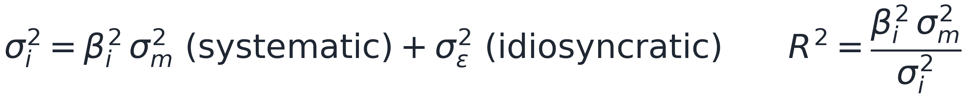
Beta and the Market Model
The single-index (market) model
Regress a stock's return on the market-index return
Beta = cov(stock, market) / var(market) - the slope of the OLS regression line
beta > 1 amplifies market moves; beta < 1 dampens them; alpha is the average return over and above the market fit
Systematic vs idiosyncratic risk
Total variance splits into systematic β² σ²(m) plus idiosyncratic σ²(ε)
R² is the share of variance explained by the market; 1 - R² is diversifiable
Risk-factor mapping (Jorion Ch.5): express each asset through its betas to common factors
Explore this live in the Session 2 dashboard: beta scatter, rolling beta, and the variance split
Notes:
New slide (Jorion Ch.5 §5.5 risk-factor mapping). Beta is an Assignment 1 deliverable and the centrepiece of the Session 2 dashboard. Emphasise the variance split: beta^2 sigma_m^2 is systematic (undiversifiable), sigma_eps^2 is idiosyncratic (diversifiable); R^2 is the systematic share.

Slide 44
Estimation Risk and Shrinkage of the Covariance Matrix
Why the sample covariance matrix is noisy
Sigma Σ has n(n+1)/2 free parameters - 465 for 30 assets - estimated from limited data
When the number of assets approaches the sample length, sample Σ becomes unstable and ill-conditioned
Extreme sample correlations are often just noise, and portfolio optimisers amplify that error
Shrinkage as a remedy (Ledoit-Wolf)
Blend the noisy sample matrix S with a structured target F: Sigma_hat = delta F + (1 - delta) S
The target is well-conditioned (e.g. constant-correlation or single-factor); delta is chosen optimally
Result: more stable correlations and better out-of-sample portfolio risk (Jorion Ch.5)
Notes:
New slide (Jorion Ch.5 §5.4). The sample covariance matrix has n(n+1)/2 parameters and is noisy when assets approach the sample length. Ledoit-Wolf shrinkage blends it toward a structured, well-conditioned target for more stable out-of-sample portfolio risk. Relevant to Assignment 3 optimisation as well.

Slide 45
Dynamic Correlations - Why They Vary
Empirical evidence
Longin & Solnik (2001): correlations rise in bear markets and fall in bull markets
COVID-19 (Feb to Mar 2020) and the GFC 2008: equity-equity correlations jumped toward +1
Rolling 21-day is noisier than 63-day; DCC-GARCH (Engle 2002) models correlation dynamics
Risk-management implications
A static Σ understates crisis portfolio losses
Diversification evaporates exactly when needed - a common factor shock lifts all correlations
EWMA Σ adapts faster than a 63-day rolling window
The Gaussian copula underestimated 2008; the t-copula adds tail dependence (next slide)
Notes:
Longin & Solnik (2001) is the landmark paper - supplementary reading. In extreme down markets correlations spike to near 1, collapsing the diversification benefit. This underpins the 'diversification fades in crises' observation from Session 1 and LTCM.

Slide 46
Copulas - Capturing Non-Linear Dependence
A copula is the "glue" that describes how variables move together, kept separate from how each one behaves alone and its main payoff in risk is that it can say whether things crash together, which a single correlation number cannot.
Tail dependence and the 2008 lesson
Tail dependence is the probability of joint extremes
Gaussian copula: no tail dependence
t-copula: positive tail dependence - some probability of joint crashes
The 2008 CDO crisis used the Gaussian copula where a t-copula was needed (Salmon 2009)
Notes:
A copula is a tool that separates two questions that usually get tangled together:
1. How does each individual thing behave on its own? (each variable's own distribution, its "marginal” distribution)
2. How do they move together? (their dependence structure)
A copula captures only the second part (the "togetherness”) stripped of the individual behaviours.
The intuition
Imagine two stocks, A and B. To model them jointly you need to know:
- how A behaves alone,
- how B behaves alone,
- and how they tend to move at the same time.
A copula is the recipe for that last piece. Sklar's theorem (the foundational result) says any joint distribution can be split into: each variable's own marginal, glued together by a copula. So you can model the margins and the dependence separately, then snap them back together. That flexibility is why copulas are popular — you are not forced to assume everything is jointly normal.
The mechanical trick
A copula works on ranks / percentiles, not raw values. You convert each variable to "where it falls in its own distribution" (a number between 0 and 1 — its percentile). The copula then describes how those percentiles pair up. Because it uses percentiles, it does not care whether A is a stock return and B is an interest rate measured on totally different scales — only the relative positions matter.
Why use in risk management -> the tails
Plain correlation gives you a single number for average co-movement, but it misses a crucial question: do these two crash together? Copulas can capture that directly, through tail dependence.
A Gaussian copula has zero tail dependence: it says that in the extreme, things become effectively independent. That assumption looked fine in calm markets and catastrophically wrong in 2008 — it was the copula baked into CDO pricing (the "formula that killed Wall Street").
- A t-copula (or Clayton copula) has positive tail dependence: it allows joint extreme losses, matching the empirical fact that assets tend to crash together.
The takeaway: correlation does not fully describe dependence, and tail dependence matters most for risk. Reference the 2008 CDO crisis (Salmon 2009, 'The formula that killed Wall Street’).

Slide 47
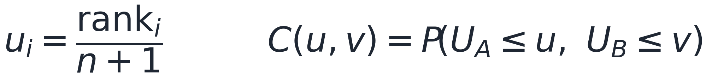
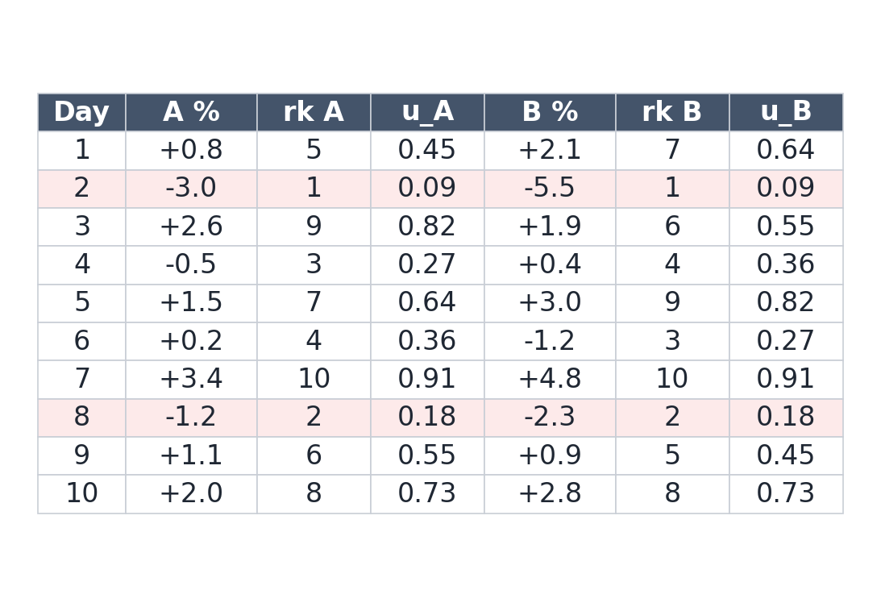
A Copula by Example: From Returns to Ranks
The recipe
Rank each stock within its OWN history (1 = worst day, 10 = best)
Convert ranks to uniforms: u = rank / (n+1), so each margin is spread evenly on 0 to 1
The copula sample
The 10 paired points (u_A, u_B) ARE the copula
They keep the co-movement but forget the actual size of each move
You get the SAME copula even if you rescale a stock by any increasing function
Read one value
Both-below-median days (u_A and u_B <= 0.5): days 2, 4, 6, 8 -> C(0.5,0.5) = 4/10 = 0.40
Independence would give 0.25 - the excess is the dependence
Notes:
Worked example, part 1. The key move is ranking each stock inside its own distribution and dividing by n+1 to get uniform margins. The paired uniforms are the copula - dependence with the marginals removed. Compute C(0.5,0.5) live: count days where both stocks are below their own median (rank <= 5): days 2,4,6,8, so 0.40 versus 0.25 under independence. The two pink rows (days 2 and 8) are the joint-worst days, used on the next slide.

Slide 48
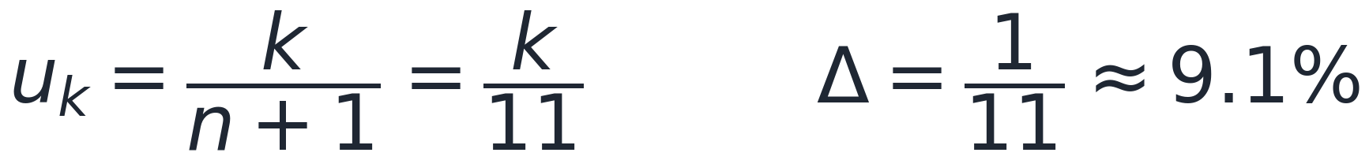
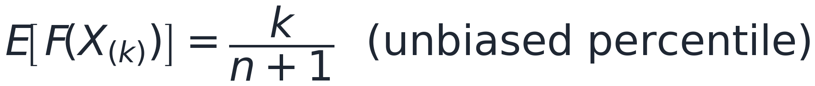
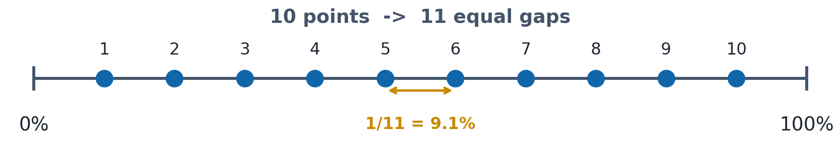
Why Divide by n + 1? (Plotting Positions)
10 points make 11 gaps
The 10 sorted returns cut the 0 to 100% probability line into n + 1 = 11 gaps (one below the min, one above the max)
A new return is equally likely to land in any gap, so each gap is worth 1/11 = 9.1%; rank k sits at k/11
Why not divide by n (= 10)?
k/n puts the largest at u = 1.0 (claiming you have seen the maximum possible) and makes Phi^{-1}(1) = +infinity in the normal-score step
k/(n+1) leaves about 9% beyond each extreme (min at 0.091, max at 0.909) - symmetric and never exactly 0 or 1
The precise reason
For the k-th smallest of n draws, E[F(X_(k))] = k/(n+1): an unbiased estimate of its percentile (the Weibull plotting position)
Notes:
Why n+1 and not n: 10 points create 11 intervals on the probability line, so each is 1/11 = 9.1% and rank k sits at k/11. Dividing by n would force the largest value to u=1 (the 100th percentile), which both claims we have seen the maximum possible outcome and sends the normal score to +infinity. The formal justification is that E[F(X_(k))] = k/(n+1), the unbiased percentile (Weibull plotting position). Mention that software cousins like (k-0.5)/n shift the values slightly but keep the same idea.

Slide 49
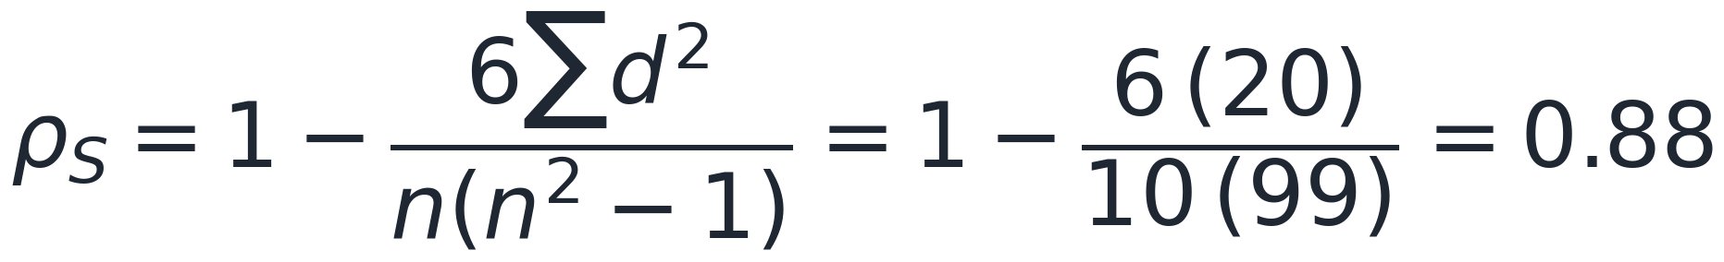
A Copula by Example: Dependence and Tails
Measure the co-movement
C(0.5,0.5) = 0.40 vs 0.25 under independence: the stocks tend to be low together and high together
Read the tails
On Stock A's two worst days (2 and 8), Stock B is also in its worst two: lower-tail dependence = 2 / 2
A Gaussian copula forces tail dependence to zero - it would miss these joint crashes
A t-copula or Clayton copula keeps positive lower-tail dependence (the 2008 CDO lesson in miniature)
Takeaway
A copula answers: when A sits at its p-th percentile, where does B tend to be?
Correlation gives one average number; the copula also shows whether they reach the extremes together
Notes:
Worked example, part 2. Spearman is just the correlation of the ranks: plug sum d^2 = 20 into the formula to get 0.88. Contrast Pearson (~0.94) on the raw returns to make the point that the copula/rank measure is scale-free while Pearson is not. Then the tails: A's two worst days coincide with B's two worst (lower-tail dependence 2/2), which a Gaussian copula cannot represent - motivating the t or Clayton copula and linking back to 2008.

Slide 50
Block 4: Python Lab
Build your volatility toolkit - the foundation of Assignment 1
Same tickers and date range as Session 1; extend the snapshot with EWMA, GARCH, beta and correlations
Save every output to CSV - these files are the direct inputs to Assignment 1 and the Session 3 VaR lab
Notes:
Block 4: hands-on. The lab notebook has five sections mapping onto today's blocks. Students use the SAME tickers and date range as Session 1; today they extend that snapshot with EWMA, GARCH, beta, and correlations.

Slide 51
Python Lab - Session_02_Lab.ipynb
Lab tasks
1. Fetch data for your 3 stocks + index (same tickers/date range as Session 1)
2. Plot stylised facts: return series, ACF of r and r², Q-Q plot, histogram vs Normal
3. Annualised vol per stock; 21-day rolling vol; beta of each stock to the index (OLS)
4. Implement EWMA (lambda = 0.94) by recursion; plot with rolling vol and VIX
5. Fit GARCH(1,1) with t-errors (arch): omega, alpha, beta, persistence, long-run vol, half-life
6. Plot GARCH conditional vol + standardised residuals; check Ljung-Box
7. Build the correlation matrix; plot rolling 63-day correlations
8. Compare the three vol forecasts (QLIKE); save all outputs to CSV
Discuss
Which model best tracks your portfolio's risk regimes?
How did correlations behave during COVID-19 or a 2022 shock?
What does GARCH persistence imply for a 10-day VaR forecast?
Notes:
Students leave with a CSV of daily returns, EWMA series, GARCH conditional vol, beta, and the correlation matrix - all on their own data. Verify lambda=0.94 and arch_model syntax.

Slide 52
Session Wrap-Up
Key takeaways
Log returns are time-additive; annualise vol by sqrt(252) and mean by 252
Returns show fat tails, volatility clustering and near-zero autocorrelation - the three stylised facts
EWMA adapts with one parameter; GARCH(1,1) adds mean reversion and a long-run variance
Beta from the market model splits risk into systematic (undiversifiable) and idiosyncratic parts
Correlations spike toward +1 in crises, destroying diversification when it matters most (Longin & Solnik 2001)
Next session - Session 3: Value-at-Risk
Parametric (normal and t) VaR, historical simulation, Monte Carlo VaR, Basel traffic-light test
Read Hull Ch. 11-13
Notes:
Tie every takeaway back to Assignment 1. Students who completed the lab have the volatility, beta and correlation inputs ready; Session 3 computes VaR from those inputs. Remind them to save CSV snapshots with a pinned end date.

